Slide 1


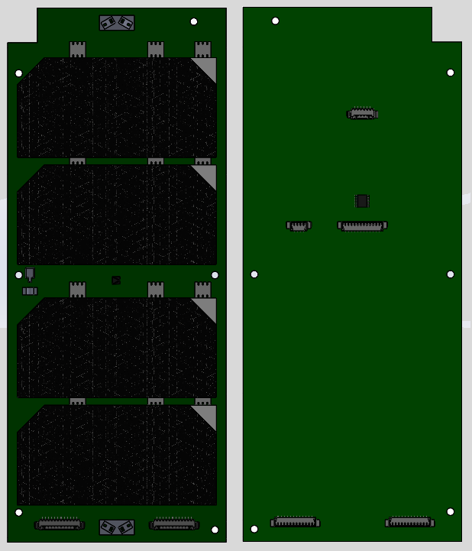
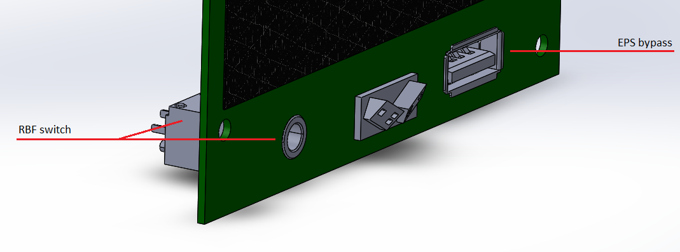
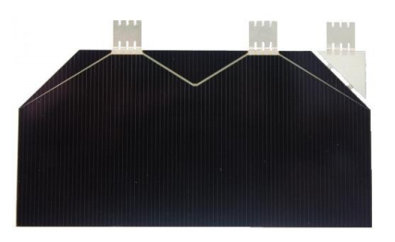
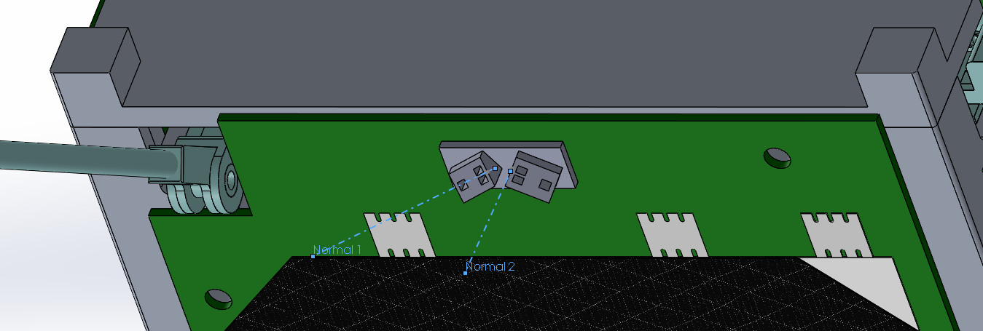
Western Cubesat Project
Cubesat Solar Panels
Stephen Amey
Introduction
Panel Variants
Power generation is a vital part of any spacecraft, and for many – including CubeSats – this requirement is often met through the use of solar panels. However for CubeSats, it is often the case that they are required to do much more as they usually make up a significant portion of the exposed surfaces. This results in several features of the CubeSat needing to use and share space on the solar panels. In addition, the assembly process of a CubeSat's solar panels involves a number of steps which must be performed with care. All of this results in making the design and assembly of a CubeSat’s solar panels a complex process.
Each solar panel holds its own unique components in order to provide the various required features, along with a set of components common to all of them. As such, there are multiple panel variants to provide all of the required functionality.
RBF and EPS Bypass
This panel hosts the Remove-Before-Flight (RBF) switch, and a bypass to the Electrical Power system.
Features
As external surface area on the is Cubesat limited, the space on the solar panels must be used carefully in order to provide all of the required features.
Power Generation
The generation of power is the most prominent use of a CubeSat’s solar panels. The solar panels must provide enough energy to the Electrical Power System in order to operate the CubeSat in the sunlight, and charge the batteries so it may operate while eclipsed.
JTAG and OBC Bypass
This panel provides an interface to the JTAG pins of the Onboard Computer (OBC), which is used to program it. It also provides a second bypass to another interface on the OBC, which is used for general control and debugging purposes.
Pictured are the AZUR SPACE 3G30A solar cells that were selected for use on the solar panels. The solar panels are to feature 4 solar cells per panel, for a total of 16 cells over all the panels.
Attitude Determination Sensors
The solar panels play a very important role in the determination of the attitude of the CubeSat, as they are the only free space where sensors may be placed. Placed on all of the panels are several photodiodes and temperature sensors, which are used to track where the incoming sunlight is coming from.
Accelerometer Bypass
The Accelerometer bypass panel provides access to the internal accelerometers. These accelerometers are used in the vibration testing of the CubeSat.
Antenna Release
For the style of antenna that was selected for the CubeSat, a surface mount and release was required. The solar panels will be responsible for featuring this, along with a sensor in order to determine that the antennas have properly deployed.
What's Next
The targeted launch date of the resupply mission carrying the CubeSat to the International Space Station is January of 2021. Before that time however, the CubeSat project must go through detailed design, assembly, integration, and testing, before finally being delivered for final integration as a payload.
Following ejection from the International Space Station, operation of the CubeSat and data processing will be maintained until the eventual orbit decay and loss of the CubeSat.
Internal Bypasses
Once components are starting to be attached, it becomes increasingly difficult to access the internal structure. The solar panels will provide bypass connectors in order to access components such as the Onboard Computer debug and programming interfaces, the Electrical Power System, and the accelerometers used for vibration testing.
RBF Switch
A Remove-Before-Flight (RBF) switch is used to stop the CubeSat from powering on at any point before its deployment. This switch is also used during testing to forcibly power on and off the CubeSat.

